Slide 1
Welcome

Slide 2
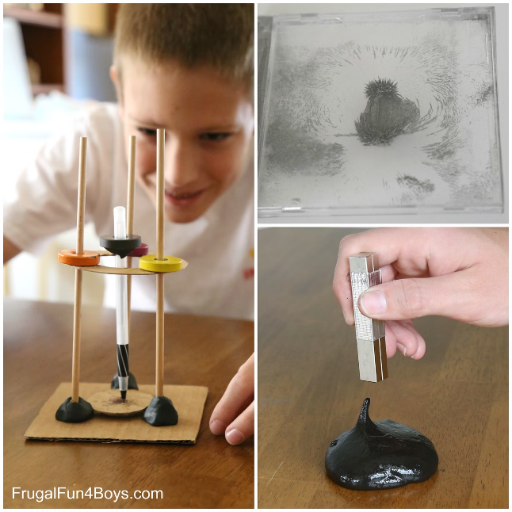
THE FUTURE OF PHYSICS
A science that deals with matter and energy and their actions upon each other in the fields of mechanics, heat, light, electricity, sound, and the atomic nucleus

Slide 3
Vision
To impart state-of-the-art knowledge of Physics to create competency and skills.
Mission
The physics department is committed to impart quality education both in theoretical as well as experimental physics with special emphasis on ‘learning by doing’ for socio-economic growth.

Slide 4
About The Department
The Bachelor of science programme in PHYSICS established in 2008 and masters Iin PHYSICS established in the year 2018 with the vision to be a centre for “hope & wellbeing”. There are five qualified faculty members with separate digital classrooms for effective teaching. A well furnished ang highly equipped laboratory. There is a collection of books and journals for the fruitful learning of the subject. Institutional visits and internship programmes are providing for UG and PG students.

Slide 5
Programme Outcomes (POs)
The outcomes of the various programs offered by the Department of Physics are as follows:
♦ Apply principles/laws of physics to solve the physical problems.
♦ Identify/formulate the complex physics problems.
♦ Design the solutions for physics problems.
♦ Conduct experiments in physics and interpret the data.
♦ Use the modern tools to learn the physics
♦ Demonstrate the physics knowledge for sustainable development.
♦ Use ethical principles and norms of physics practice.
♦ Communicate the physics effectively.
♦ Demonstrate the knowledge in physics to manage the physics projects effectively.

Slide 6
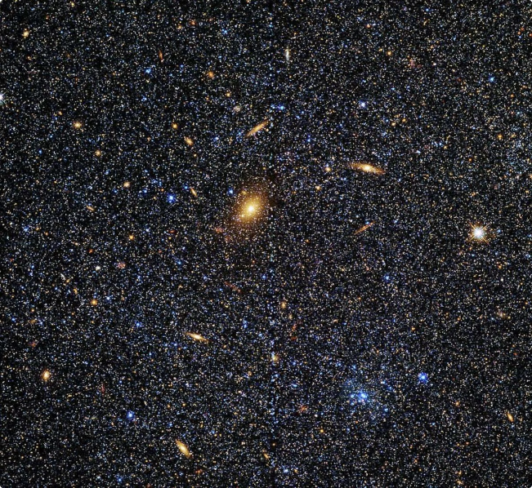
What Are the Subjects in Physics?
Electromagnetism and Photonics
Classical Mechanics
Relativistic Mechanics
Thermodynamics and Statistical Mechanics
Quantum Mechanics
Atomic Physics
Molecular Physics
Condensed Matter Physics
Optics and Acoustics
High-energy Particle Physics
Nuclear Physics
Relativity and Cosmology
Advanced Optics
Solid State Physics
Astrophysics
Atomic Spectroscopy
.

Slide 7
Careers in Physics
Lab Technician
Teacher
Optical Engineer
Research Assistant
Research Scientist
Medical Physicist
Astronomer
Aerospace Engineer
Geophysicist

Slide 8
Further Study Options After Physics
MBA in Data Science
MBA in Information Technology
PG Diploma in Data Science
PG Diploma in Astronomy
PG Diploma in Nanotechnology
Diploma in Medical Lab Technology
Post Graduate degrees in astrophysics, quantum physics, particle physics, nanotechnology, and thermodynamics.

Slide 9
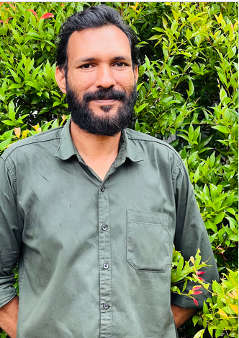
Faculties Of Physics Department
SUHRA P.V
M.Sc. Physics
AMRUTHA. K.P
M.Sc. computer science
JISHAD EK
M.Sc. Physics, M.Phil.
RAJEEV V V
M.Sc. Physics
SREE VIDYA M
M.Sc. Physics

Slide 10
Facilities Of Our College
Physics Lab
Advanced Computer Lab
Well Equipped Library
Canteen
Free Transport Service
Internet Service
College Hostel
Club Activities
Play Ground
Highly Qualified And Well Experienced Staff
Seminar Hall
Prayer Hall
Strong Security System

Slide 11
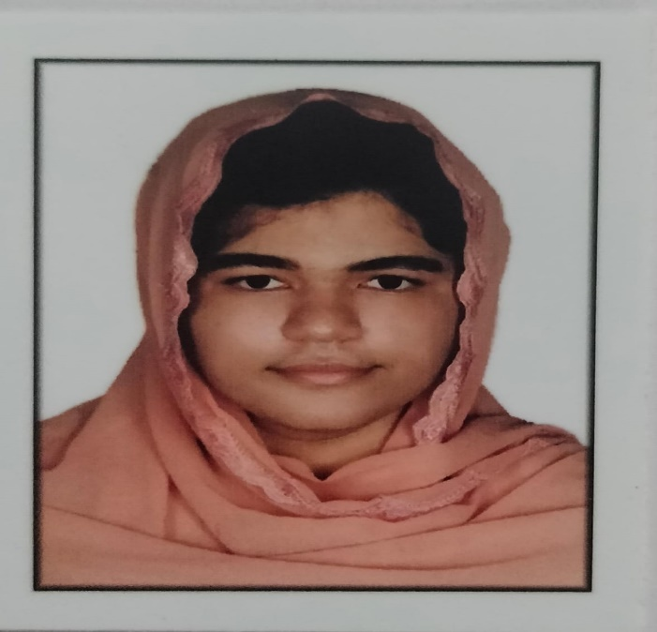
Our Achievements
M.Sc. PHYSICS 2022-2024 TOPPERS
ARSHIDA K A
A⁺ GRADE
THAHIRA K
A⁺ GRADE

Slide 12
Department Events
1.ASSOCIATION PROGRAMMS
2.SEMINARS
3.PAPER PRESENTATIONS
4.INSTITUTION VISITS
5.FIELD TRIPS
6.WORKSHOP
7.EXHIBITION
8.AWARD CEREMONIES
9.PUZZLE DAY

Slide 13
How To Apply
Visit the website of Calicut University for detailed information about the application process, deadlines, and requirements. You can also contact our admissions office for any questions.

Slide 14
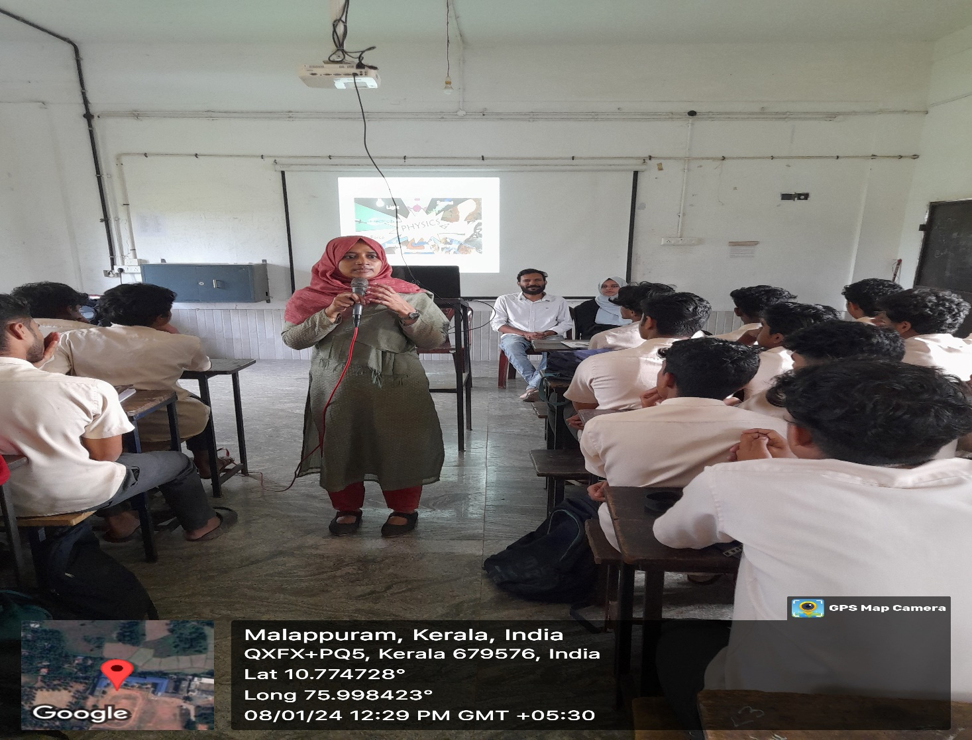
ORIENTATION PROGRAMME
.

Slide 15
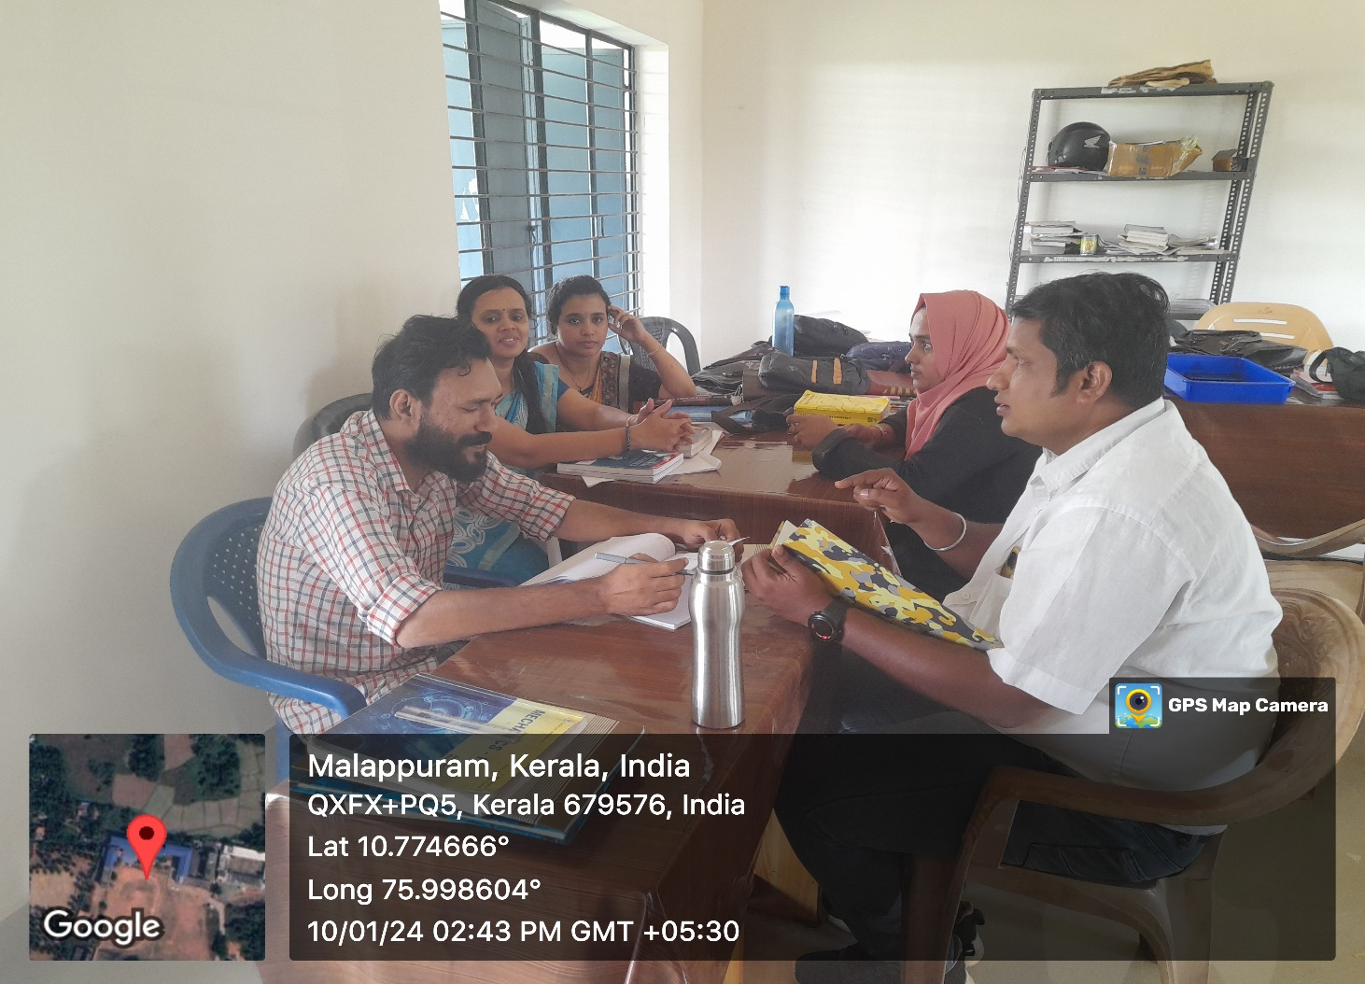
Department Meetings

Slide 16
Documentory–Science Day

Slide 17
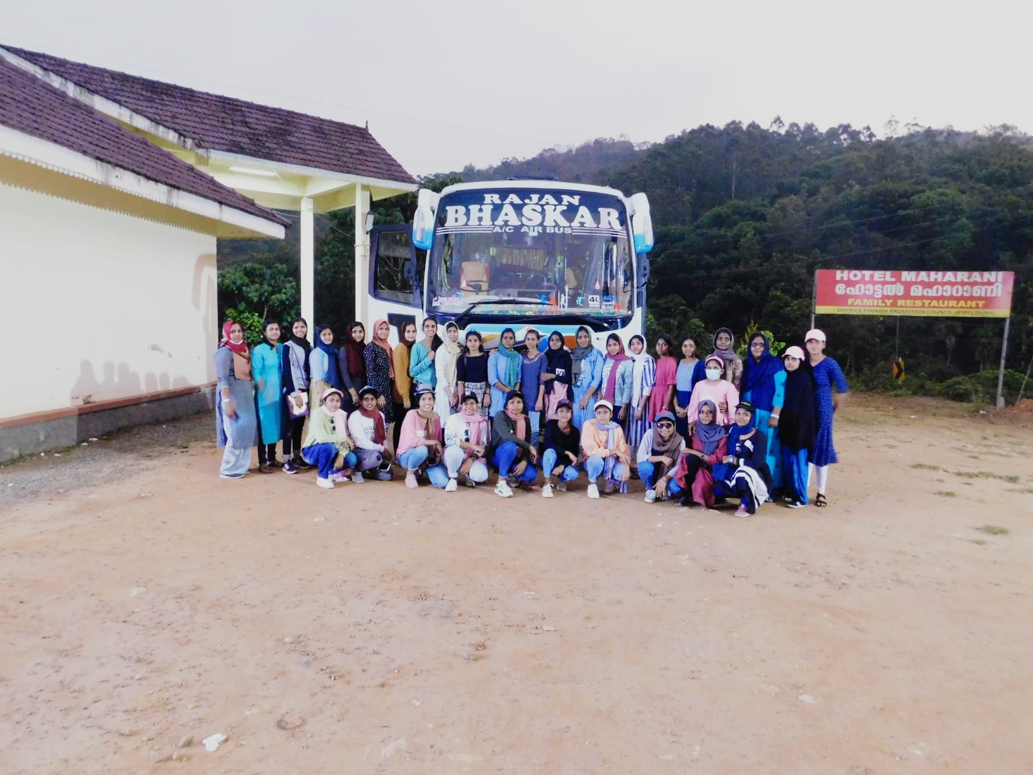
Study TOUR

Slide 18
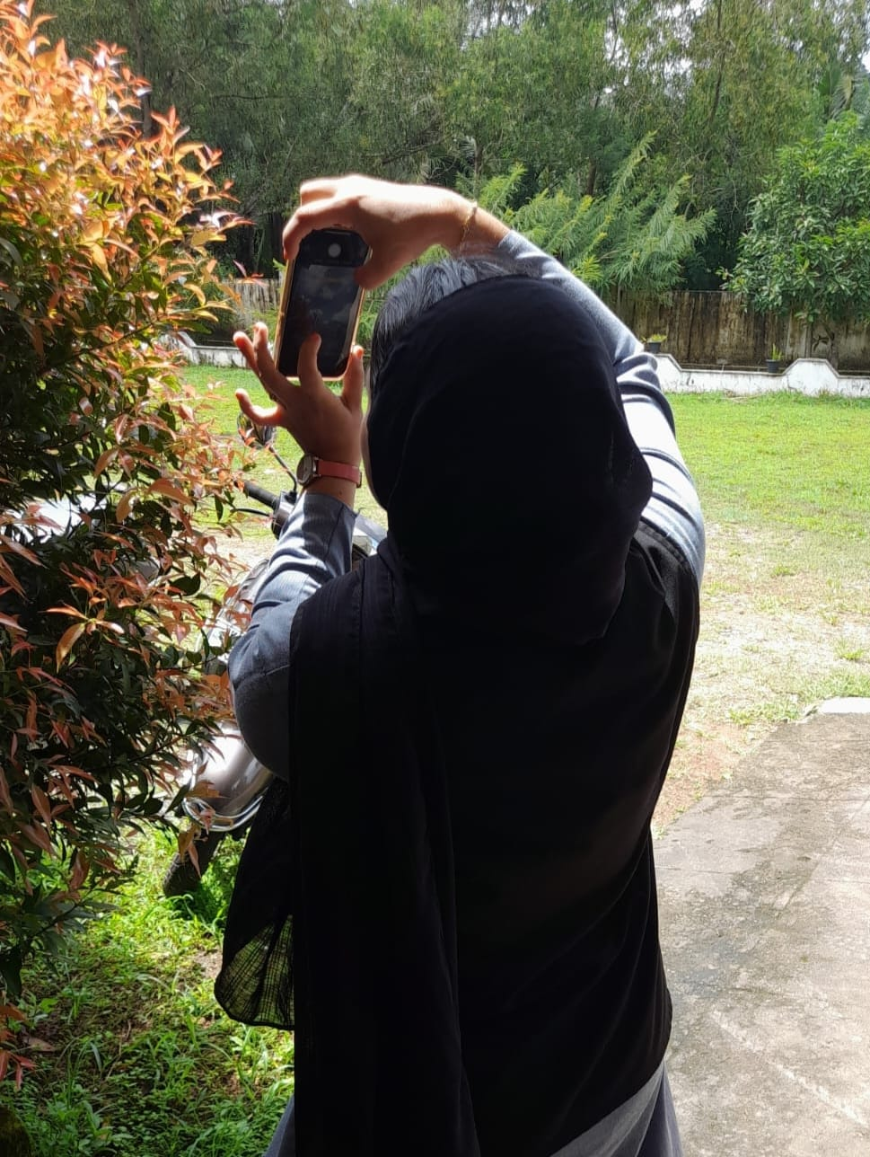
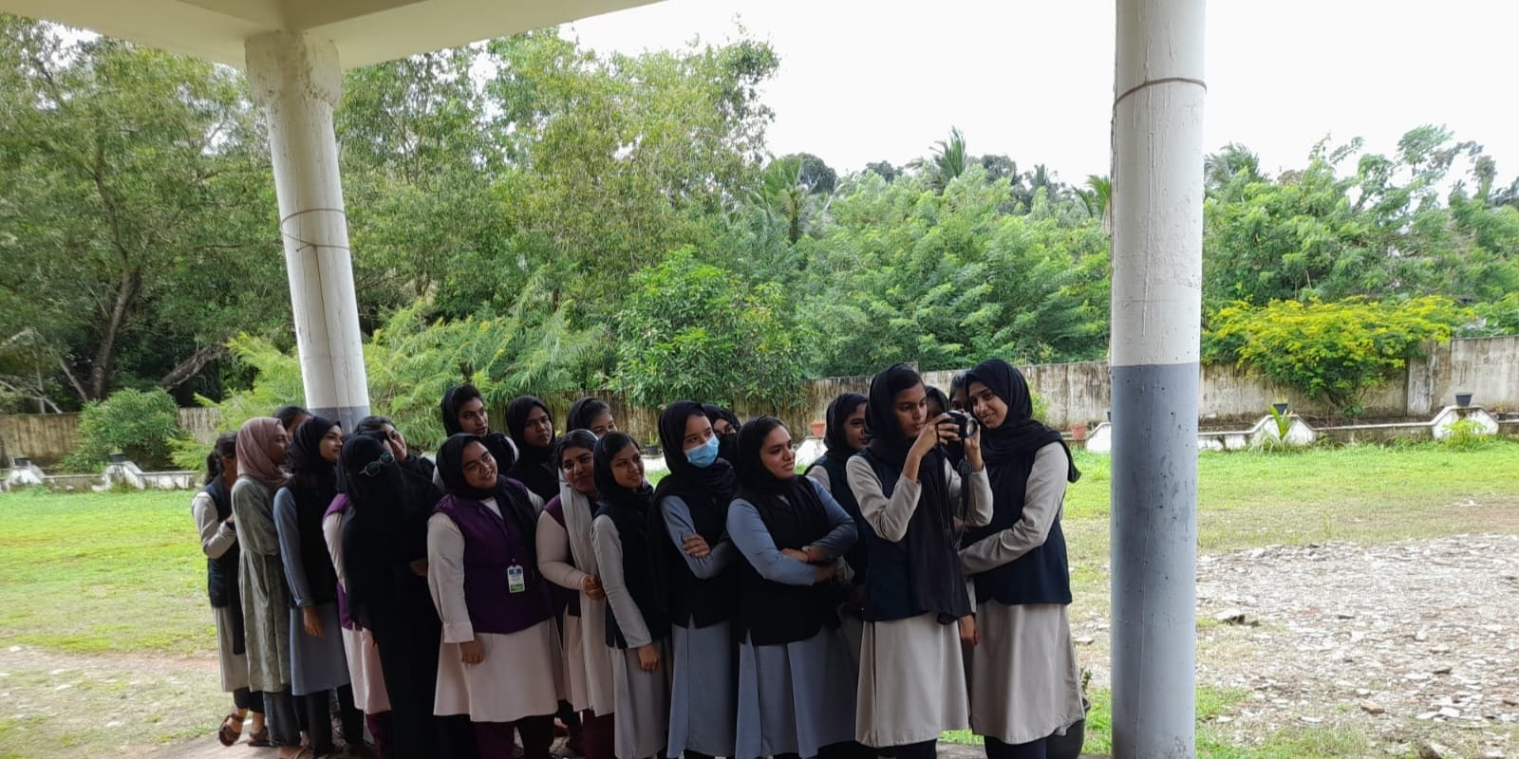
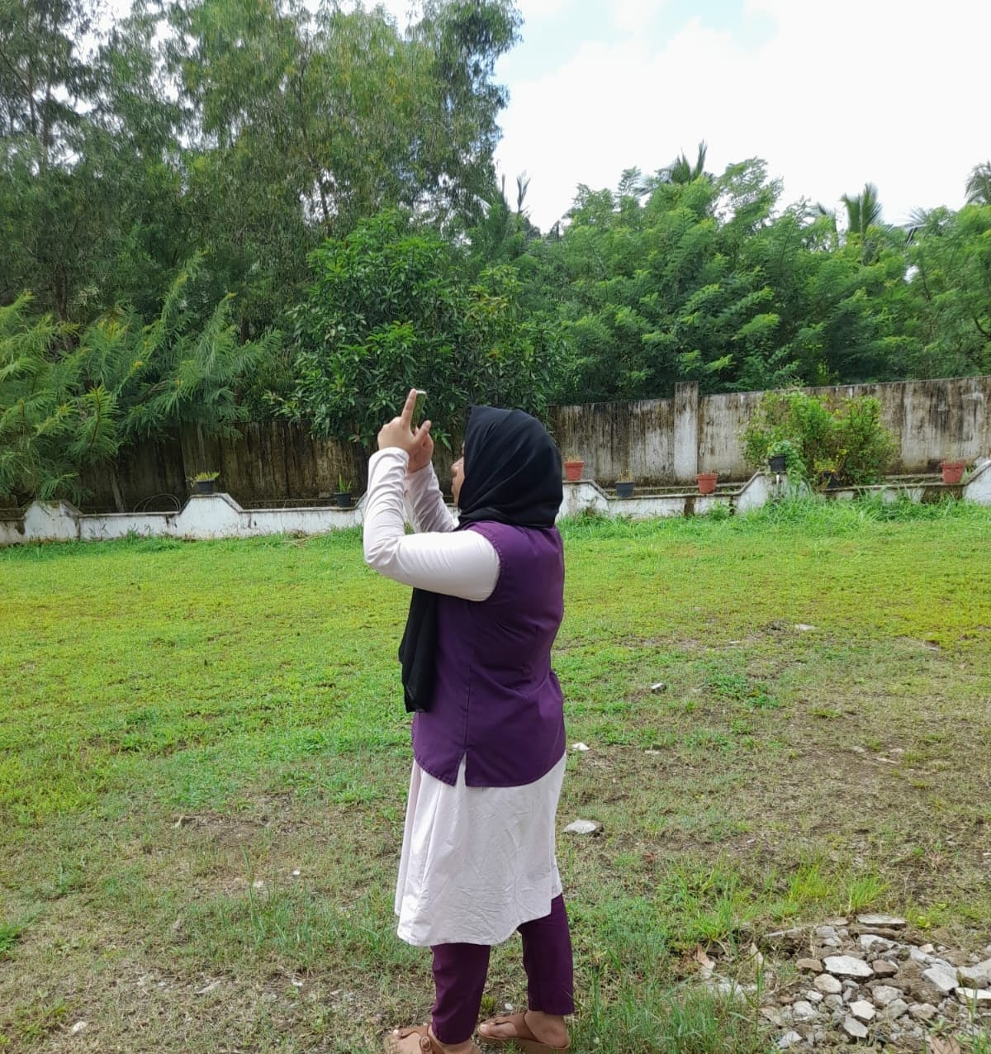
Photo contest

Slide 19
How To Reach
Take Bus From EDAPPAL Town To POOKKARATHARA,
Nearly 2 KM From Edappal Town , Athani Road

Slide 20
Contact Us
Hidaya Campus,
Pookkarathara , Kololamba PO,
Malappuram Dt, Pin - 679579 Telephone: +91 8593000166 Office : 0494 2684067 Principal: 8593000164 Email: kvumcollege@gmail.com

Slide 21
Thank You

